Slide 1
Industrial Platforms
Subject Name: Platform Based Development
Subject Code: PBDE401 | PBDV301
Lecturer Name : Freedom
Department : Information Technology

Slide 2
Outline of the lesson
Objectives
Understanding what are platforms in the industrial context
Understanding two predominant forms of platforms and their design principles
  Company-Specific Platforms (Internal)
  Industry –wide Platforms (External)
Understanding the goal and purpose of Robotics
Key principles and methods for robotics systems
Types of Robotic software and ROS achitecture

Slide 3
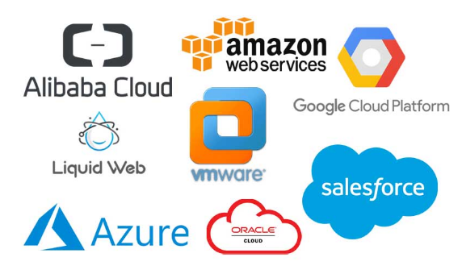
Types of Industrial Platforms
The term “ Platform” has become ubiquitous.
Platforms exist in a variety of industries, especially in high-tech businesses driven by information technology.
For example : Microsoft, Apple, Google, Intel – hardware, software products + applications (each has its platform – see image below)
Often associated with “ Network Effect “ – driven by complementary innovations

Slide 4
Types of Industrial Platforms
Industry platforms and associated innovations, as well as platforms on top of or embedded within other platforms have become increasingly pervasive in our everyday lives. Industrial platforms are digital systems used to monitor, control, and analyze industrial operations
  Industrial Internet of Things (IIoT) Platforms (Connect machines/devices e.g., GE Predix, MindSphere).
  Cloud Computing Platforms (Handle big data, AI models, dashboards e.g., Azure, AWS).
  Data Analytics Platforms (Analyze industrial data for insights, predictive maintenance, and optimization e.g., Power BI, IBM Watson Analytics )
  Enterprise Resource Planning Platforms (Resource, order, and inventory management)
  Platforms
  Collaborative Platforms (Enable teamwork, sharing data, workflows, and real-time communication across teams and robots e.g., Microsoft Teams with integrated Power Automate, Slack
  Energy Management Platforms (Monitor and optimize energy consumption across industrial equipment e.g., Schneider Electric EcoStruxure )

Slide 5
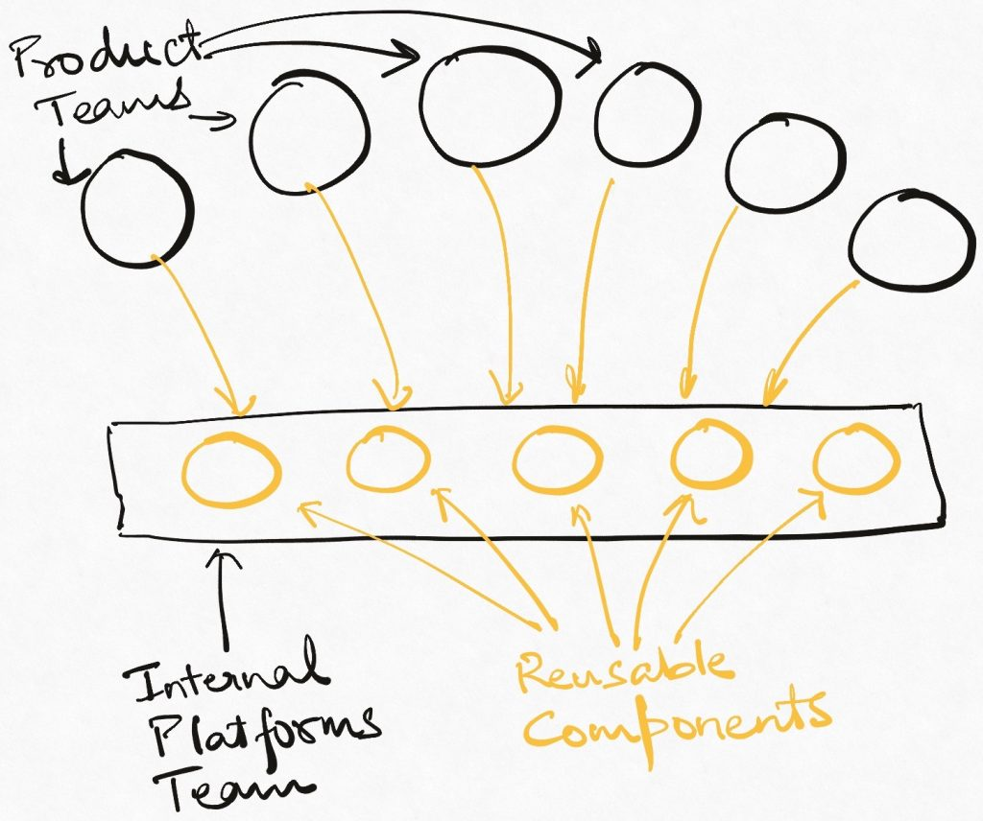
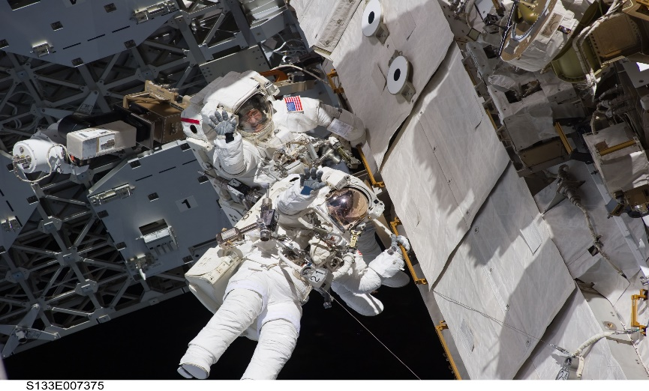
Types of Industrial Platforms
Two predominant forms of platforms
  Internal or company-specific platforms
  External or industry-wide platforms

Slide 6
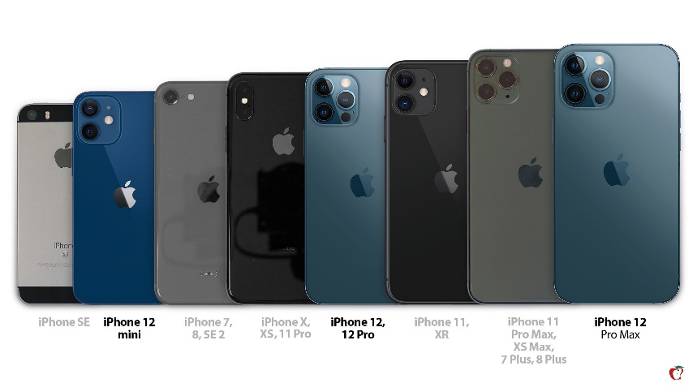
Types of Industrial Platforms
Internal or company-specific platforms
Characteristics
  In the context of new product development and incremental innovation around reusable components or technologies.
  Involves building a family of related products or sets of new features by deploying these components.
  For example: Product Platforms - How can the needs of different customers be met?
  Produce a family of automobile products or consumer electronics devices etc.

Slide 7
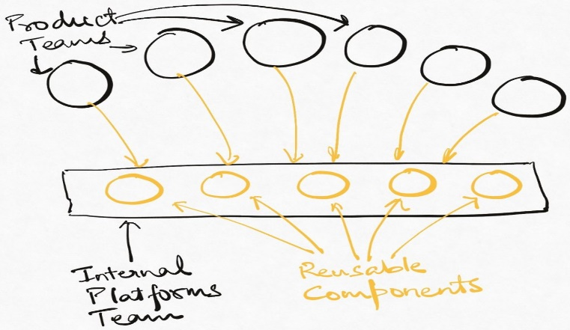
Types of Industrial Platforms
Internal or company-specific platforms
Design Principles
  The stability of the system architecture
  The systematic or planned reuse of modular components
  Trade-off : functionality and performance
  Optimization of subsystem

Slide 8
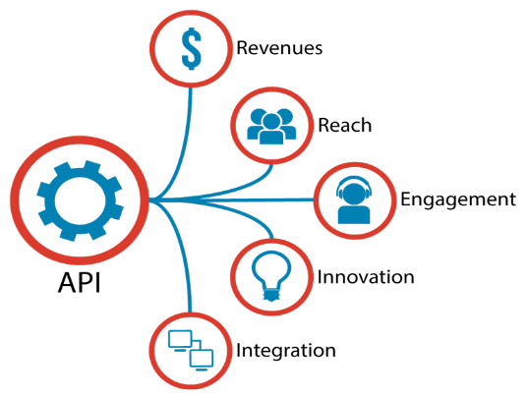
Types of Industrial Platforms
External or industry-wide platforms
Characteristics
  Products, services or technologies developed by one or more firms, and which serve as foundations upon which a larger number of businesses can build further complementary innovations.
  Perform a function that is essential to a broader technological system and solve a business problem for many businesses and users in the industry.
  Openness – vary on a number of dimensions – such as level of access to information on interfaces to link to the platform or utilize its capabilities or cost of access.
For example – mobile application APIs + Cloud computing platforms cost

Slide 9
Types of Industrial Platforms
External or industry-wide platforms
Various products and technologies serve as industry platforms
  Microsoft Windows and Linux operating systems
  Intel and ARM microprocessors;
  Apple’s iPod, iPhone, and iPad along with the iOS operating system and iTunes and the Apple App Store
  Google’s Internet search engine
  Android operating system for smart phones,
  Social networking sites such as Facebook, LinkedIn, and Twitter
  Internet

Slide 10

Types of Industrial Platforms
External or industry-wide platforms
Design Principles
  The stability of the system architecture is essential
  The logic of design is inverted.
  The interfaces around the platform must be sufficiently “open” to allow outside firms to “plug in” complements as well as innovate on these complements and make money from their investments

Slide 11
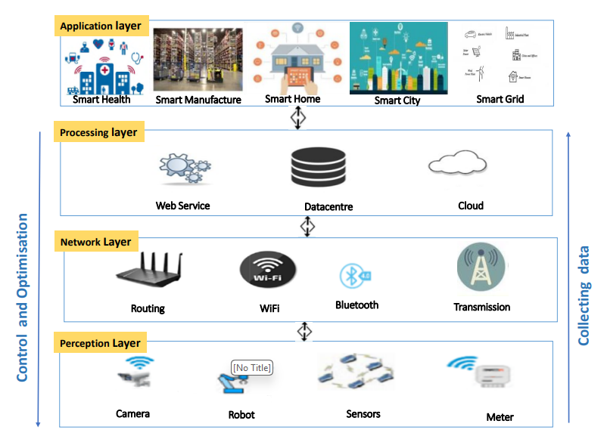
High-Level IoT/IIoT Architecture

Slide 12
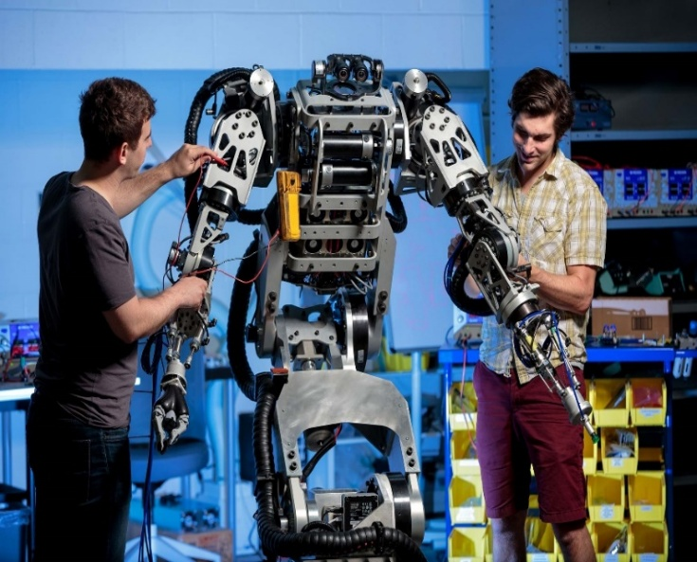
Robotics in Industry
The goal of robotics in any industry is to design machines that can help and assist humans (and other robots in some instances).
To automate repetitive, dangerous, or precision tasks in industrial environments, improving productivity, quality, and worker safety.
Robotics involves design, construction, operation, and use of robots.
Robotics is an interdisciplinary branch of computer science and engineering.
Benefits
  Increase manufacturing efficiency and consistency
  Reduce human error and workplace injuries
  Enable flexible production for customized products
  Optimize operational costs through automation

Slide 13
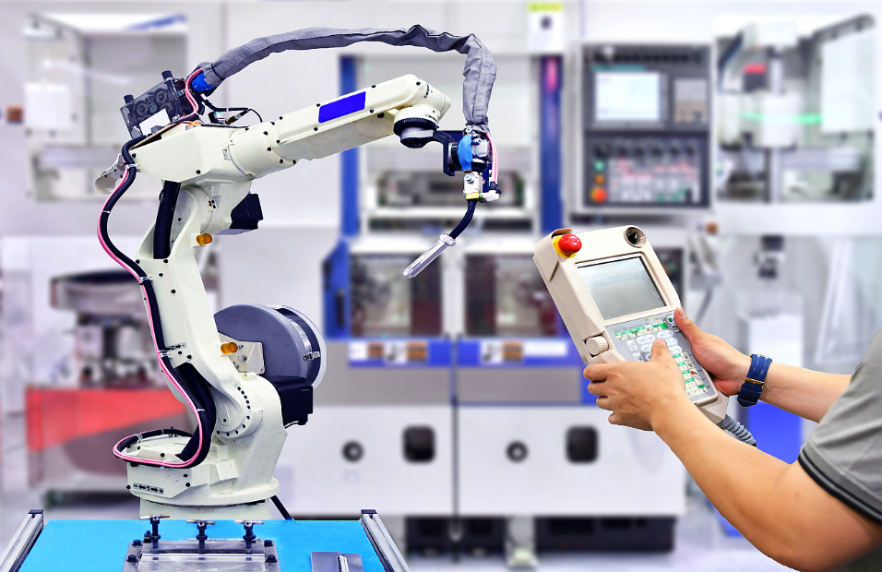
Robotics Foundation
Some fundamental principles and methods needed to create a robotic systems
Mechanics and Kinematics
Sensors and perception
Control Systems
Artificial Intelligence (Machine learning & Deep learning)
Software Development
Human-robot interaction
Safety and Ethics

Slide 14
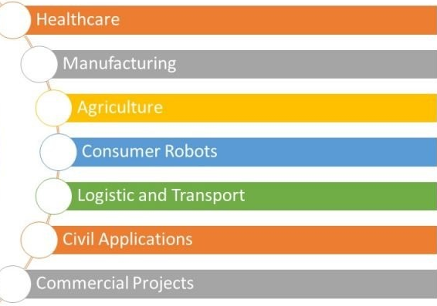
Application of Robotics
Robotic Arms
  Perform precise tasks such as welding, assembly, and painting
  Common in automotive, electronics, and metal fabrication industries
Automated Guided Vehicles (AGVs)
  Transport materials autonomously within factories and warehouses
  Increase logistics efficiency and reduce manual labor
Drones
  Inspect difficult-to-access areas and monitor inventory
  Useful for safety inspections and site mapping

Slide 15
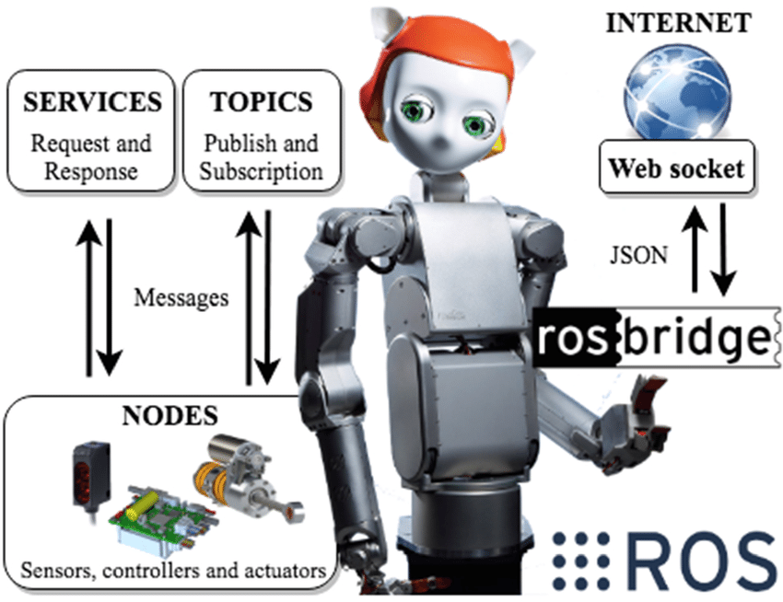
Robotics Software
There are variety of different types of software available in the robotics industry.
Specific robotics software packages, mostly come packaged with the particular brands of robot.
Types of Robotic Software
  Robot Operating Systems – ROS (ROS, ROS2)
  Programming Environments (ABB’s RAPID, Fanuc’s Karel, KUKA’s KRL)
  Simulation Software (Gazebo, V-REP (CoppeliaSim), RoboDK, MATLAB Robotics Toolbox)
  Control Software (Beckhoff TwinCAT, Siemens TIA Portal)
  Vision and Sensor Integration Software (Cognex VisionPro, OpenCV, Intel RealSense SDK)
  Fleet or Swarm Management Platforms (FetchCore, GreyMatter, LocusONE)

Slide 16
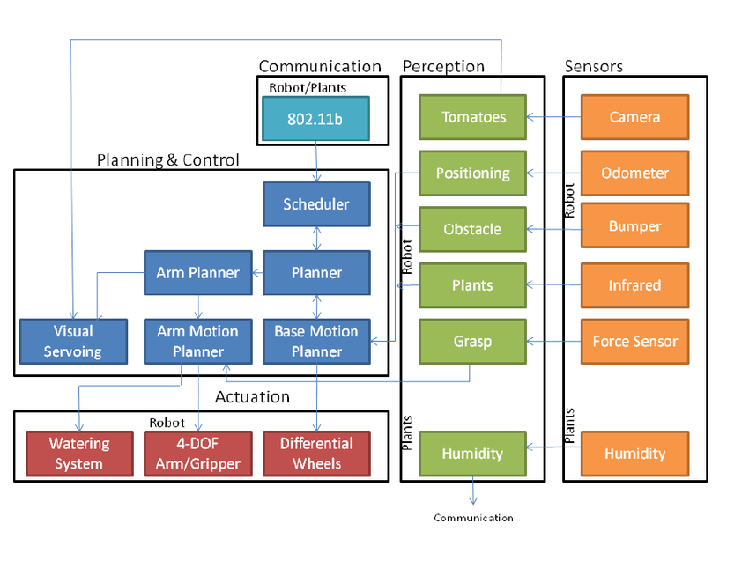
RO2 Architecture
Click here: https://medium.com/software-architecture-foundations/robot-operating-system-2-ros-2-architecture-731ef1867776

